Slide 1
LSTM: An Illustration
Dr Gangothri Rajaram

Slide 2
The Problem of Recurrent Neural Networks
Short-term memory
Vanishing gradient problem

Slide 3
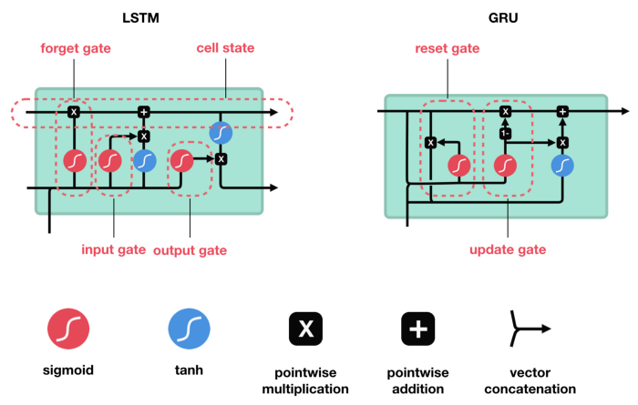
LSTM and GRU

Slide 4

Intuition

Slide 5
Intuition

Slide 6
Recurrent Neural Networks: Processing sequence one by one

Slide 7
Recurrent Neural Networks: Passing hidden state to next time step

Slide 8
Recurrent Neural Networks: RNN Cell

Slide 9
Recurrent Neural Networks: Tanh activation

Slide 10
vector transformations without tanh

Slide 11
vector transformations with tanh

Slide 12
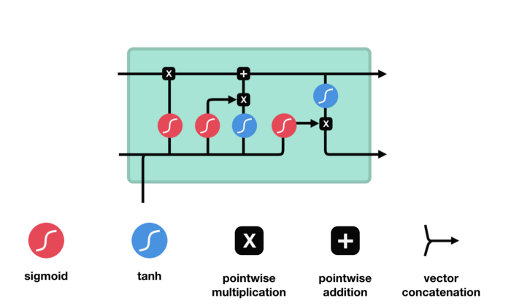
Long Short-Term Memory (LSTM): LSTM Cell and It’s Operations

Slide 13
Long Short-Term Memory (LSTM): Sigmoid

Slide 14
Long Short-Term Memory (LSTM): Forget gate operations

Slide 15
Long Short-Term Memory (LSTM): Input gate operations

Slide 16
Long Short-Term Memory (LSTM): CELL STATE operations

Slide 17
Long Short-Term Memory (LSTM): OUTPUT GATE operations

Slide 18
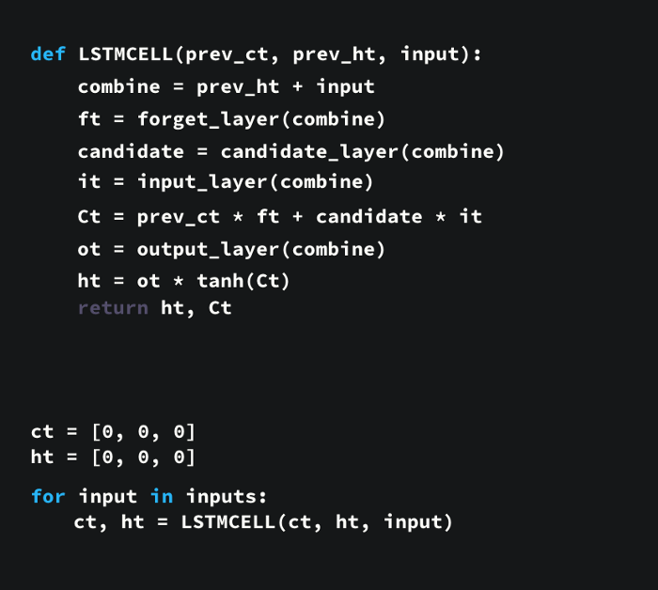
Long Short-Term Memory (LSTM): OUTPUT GATE operations

Slide 19
